Slide 1

Working with LoopBack Models
Raymond Feng
Co-Founder and Architect

Slide 2
About StrongLoop
Founded 2012
Develop and support…
  LoopBack: Open Source Mobile Backend-as-a-Service
  StrongOps (formally NodeFly): Real-time performance monitoring
  StrongNode: Support for StrongLoop and public Node.js modules
Also maintains and/or contributes to the npm ecosystem:
  node-inspector, node-reggie plus over 30 more modules

Slide 3



The Problem: Apps Need Data
Not authorized (AAA)
XML (Transform)
Too much data (Filter)
Combine multiple DBs (Join)
50k phones kill DB (Cache)

Slide 4
Introducing LoopBack
How can we build scalable Enterprise mobile apps?
Mobile Backend-as-a-Service (e.g. a private Parse you control)
Connects devices and browsers to Enterprise data
Written in Node.js – proven language for mobile backends
Open source – extensible by design
On-premise or on your favorite cloud
Android and iOS SDKs

Slide 5
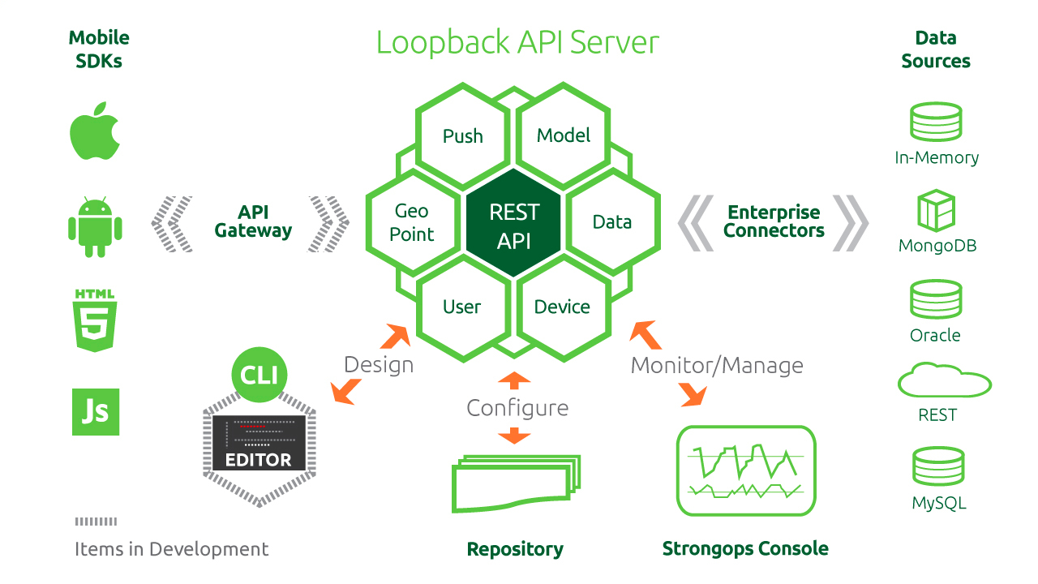
LoopBack Architecture

Slide 6
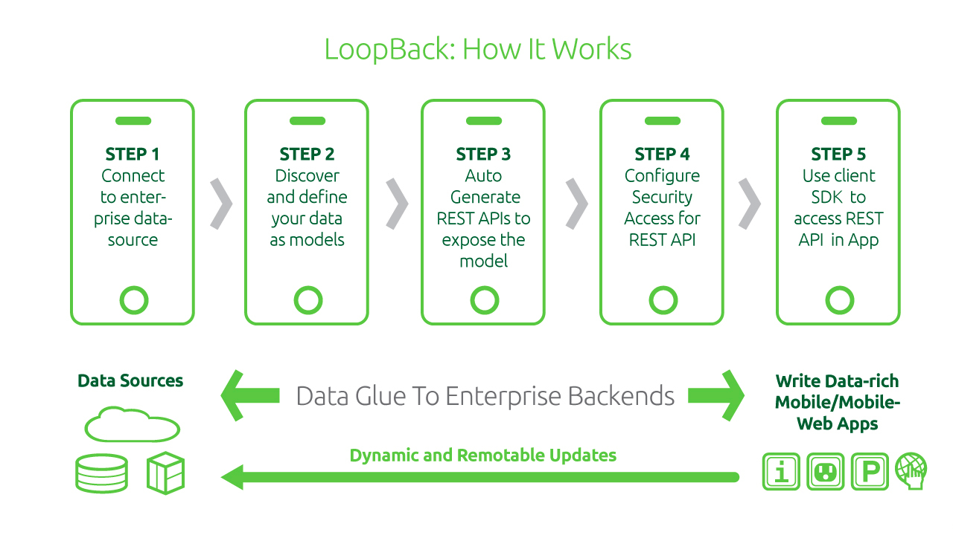
How it Works

Slide 7
LoopBack
Backend for mobile applications (native, web, and hybrid)
Frontend for traditional enterprise systems
Model = data + behavior.
Isomorphic models: LoopBack, backend DBs, frontend

Slide 8
Model = Data + Behavior
Rich mobile applications are driven by data.
Data is created and consumed by mobile devices, browsers, cloud services, legacy apps, databases, and other backend systems.
Mobilizes data through models that represent business data and behavior.
Exposes models to mobile apps through REST APIs and client SDKs.
You need to interact with the model differently, depending on the location and type of data.

Slide 9
The big picture
Settings
host: …
port: …
user: …
password: …
initialize
Data Source
Connector
Discovery
Model Definition
id: String,
name: String,
age: Number
DataAccessObject
Cloud
APIs
define (data)
RDB
mixin (behaviors)
NoSQL
Model
Constructor
strong-remoting
attachTo
Custom Methods
Hooks
Validations
Relations
Mobile/JS SDKs
REST clients

Slide 10
Choose Your Camp and Recipes
Open Models
  “I don’t know my data model yet. Let’s start free form and show me the CRUD APIs!”
Models with schema
  “Now I can tell you more information about my data model. Let’s add properties!”
Discover models
  “Hey, I already have data in relational databases such as Oracle or MySQL. Can the table schema be my data model?”
Models by instance introspection
  “Sorry, I’m a NoSQL guy and I have JSON documents for my data. Reverse engineering?”
Model synchronization with relational databases
  “Now I have the data model, should I beg the DBA to create/update the tables/columns for me?”

Slide 11

Recipe 1
I'm mobile developer. Can LoopBack help me store and load data transparently? I don't need to worry about the backend or define the model up front, because my data are free-form.

Slide 12
Open Models
Open models are perfect for free-form data or API mockup
npm install –g strong-cli
slc lb project loopback-models
cd loopback-models
slc lb model form
slc run app
http://localhost:3000/explorer

Slide 13
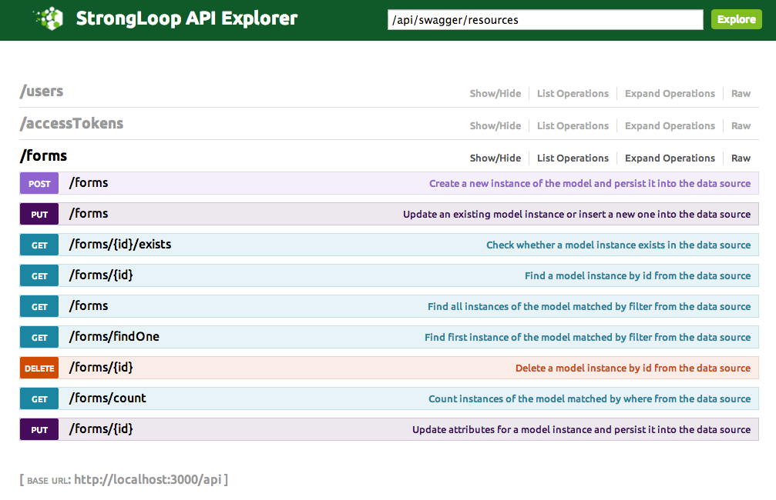
Explore the APIs

Slide 14
Recipe 2
I want to build a mobile application that will interact with some backend data. The structure/types of my data are known. I would love to see a working REST API and mobile SDK before I implement the server side logic.

Slide 15
Define the model
// Load the MongoDB data source
var ds = require('../data-sources/db.js')('mongodb');
// Define a customer model
var Customer = ds.createModel('customer', {
id: {type: Number, id: true},
name: String,
emails: [String],
age: Number},
{strcit: true});

Slide 16
Do some CRUD
Customer.create({
name: 'John1',
emails: ['john@x.com', 'jhon@y.com'],
age: 30
}, function (err, customer1) {
console.log('Customer 1: ', customer1.toObject());
Customer.create({
name: 'John2',
emails: ['john@x.com', 'jhon@y.com'],
age: 30
}, function (err, customer2) {
console.log('Customer 2: ', customer2.toObject());
Customer.findById(customer2.id, function(err, customer3) {
console.log(customer3.toObject());
});
Customer.find({where: {name: 'John1'}, limit: 3}, function(err, customers) {
customers.forEach(function(c) {
console.log(c.toObject());
});
});
});

Slide 17
Recipe 3
I have data in an Oracle or MySQL database. Can LoopBack figure out the models and expose them as APIs to my mobile applications?

Slide 18
Connect to Oracle
var loopback = require('loopback');
var ds = loopback.createDataSource('oracle', {
"host": "demo.strongloop.com",
"port": 1521,
"database": "XE",
"username": "demo",
"password": "L00pBack"
});

Slide 19
Discover and run
var ds = require('../data-sources/db.js')('oracle');
/**
* Discover and build models from INVENTORY table
*/
ds.discoverAndBuildModels('INVENTORY', {visited: {}, owner: 'LOOPBACK', associations: true}, function (err, models) {
models.Inventory.findOne({}, function (err, inv) {
if (err) {
console.error(err);
return;
}
console.log("\nInventory: ", inv);
inv.product(function (err, prod) {
console.log(err);
console.log("\nProduct: ", prod);
console.log("\n ------------- ");
});
});

Slide 20
Recipe 4
I have JSON documents from REST services and NoSQL databases. Can LoopBack introspect my models from them?

Slide 21
Sample JSON document
// Instance JSON document
var user = {
name: 'Joe',
age: 30,
birthday: new Date(),
vip: true,
address: {
street: '1 Main St',
city: 'San Jose',
state: 'CA',
zipcode: '95131',
country: 'US'
},
friends: ['John', 'Mary'],
emails: [
{label: 'work', eid: 'x@sample.com'},
{label: 'home', eid: 'x@home.com'}
],
tags: []
};

Slide 22
Build a model from JSON
var ds = require('../data-sources/db.js')('memory');
// Create a model from the user instance
var User = ds.modelBuilder.buildModelFromInstance('MyUser', user, {idInjection: true});
User.attachTo(ds);
// Use the model for CRUD
User.create(user, function (err, u1) {
console.log('Created: ', u1.toObject());
User.findById(u1.id, function (err, u2) {
console.log('Found: ', u2.toObject());
});
});

Slide 23
Recipe 5
Now I have defined a LoopBack model, can LoopBack create or update the relational database schemas for me?

Slide 24
Model synchronization
LoopBack provides two ways to synchronize model definitions with table schemas:
Auto-migrate: Automatically create or re-create the table schemas based on the model definitions. WARNING: An existing table will be dropped if its name matches the model name.
Auto-update: Automatically alter the table schemas based on the model definitions.

Slide 25
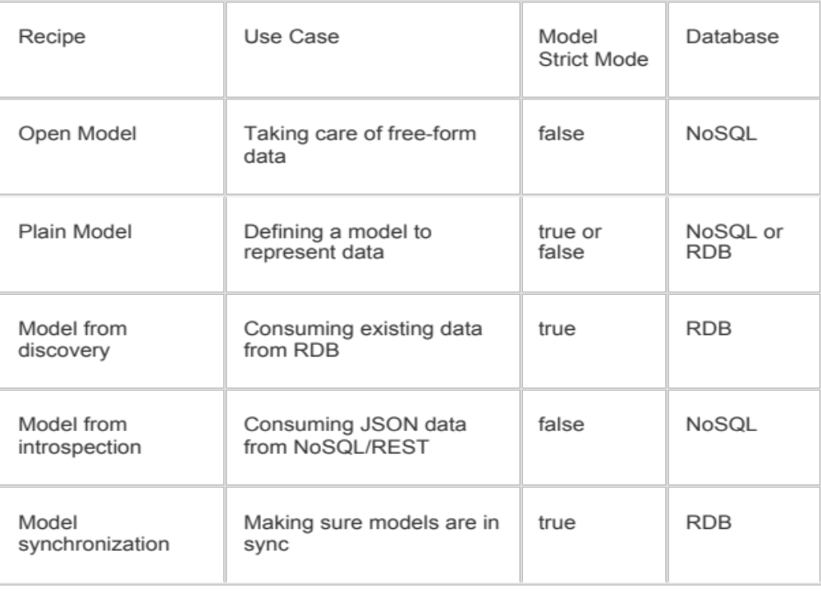
Summary

Slide 26
What’s Next?
Try LoopBack
  strongloop.com/get-started/
RTFM
  docs.strongloop.com
Questions?
  groups.google.com/forum/#!forum/strongloop
  or callback@strongloop.com

Slide 27
Recipe 6: Relations
Models are often connected/related. For example,
  A customer has many orders and each order is owned by a customer.
  A user can be assigned to one or more roles and a role can have zero or more users.
  A physician takes care of many patients through appointments. A patient can see many physicians too.

Slide 28
belongsTo
Order
_______________________
id: Number
customerId: Number
orderDate: Date
Customer
_______________________
id: Number
name: String
customer
var Order = ds.createModel('Order', {
customerId: Number,
orderDate: Date
});
var Customer = ds.createModel('Customer', {
name: String
});
Order.belongsTo(Customer);
...
order.customer(callback); // Get the customer for the order
order.customer(); // Get the customer for the order synchronously
order.customer(customer); // Set the customer for the order

Slide 29
hasMany
Customer
_____________________
id: Number
name: String
Order
____________________
id: Number
customerId: Number
orderDate: Date
orders
var Order = ds.createModel('Order', {
customerId: Number,
orderDate: Date
});
var Customer = ds.createModel('Customer', {
name: String
});
Customer.hasMany(Order, {as: 'orders', foreignKey: 'customerId'});
...
customer.orders(filter, callback); // Find orders for the customer
customer.orders.build(data); // Build a new order
customer.orders.create(data, callback); // Create a new order for the customer
customer.orders.destroyAll(callback); // Remove all orders for the customer
customer.orders.findById(orderId, callback); // Find an order by id
customer.orders.destroy(orderId, callback); // Delete and order by id

Slide 30
hasMany through
physicians
Physician
_____________________
id: Number
name: String
Appointment
_______________________
id: Number
physicianId: Number
patientId: Number
appointmentDate: Date
Patient
___________________
id: Number
name: String
patients
var Physician = ds.createModel('Physician', {name: String});
var Patient = ds.createModel('Patient', {name: String});
var Appointment = ds.createModel('Appointment', {
physicianId: Number,
patientId: Number,
appointmentDate: Date
});
Physician.hasMany(Patient, {through: Appointment});
Patient.hasMany(Physician, {through: Appointment});
physician.patients(filter, callback); // Find patients for the physician
physician.patients.build(data); // Build a new patient
physician.patients.create(data, callback); // Create a new patient for the physician
physician.patients.destroyAll(callback); // Remove all patients for the physician
physician.patients.add(patient, callback); // Add an patient to the physician
physician.patients.remove(patient, callback); // Remove an patient from the physician
physician.patients.findById(patientId, callback); // Find an patient by id

Slide 31
hasAndBelongsToMany
assemblies
Assembly
_____________________
id: Number
name: String
Part
____________________
id: Number
partNumber: String
AssemblyPart
_______________________
assemblyId: Number
partId: Number
parts
var Assembly = ds.createModel('Assembly', {name: String});
var Part = ds.createModel('Part', {partNumber: String});
Assembly.hasAndBelongsToMany(Part);
Part.hasAndBelongsToMany(Assembly);
...
assembly.parts(filter, callback); // Find parts for the assembly
assembly.parts.build(data); // Build a new part
assembly.parts.create(data, callback); // Create a new part for the assembly
assembly.parts.add(part, callback); // Add an part to the assembly
assembly.parts.remove(part, callback); // Remove an part from the assembly
assembly.parts.findById(partId, callback); // Find an part by id
assembly.parts.destroy(partId, callback); // Delete and part by id

